Slide 1
Project Topic Proposal (Group 5)
Sriram Rajiv Karri (11170417)
Vijay Sai Chigullapally (11810022)
Ruthvik Bairaboina (11819162)
Fahmida Yasmin Rifat (11812777)
Muhammad Zubair Hasan (11812741), Team Leader

Slide 2
Contents
Product vision
Features
Why our product is unique ?
Project Prototype
Implementation Details

Slide 3
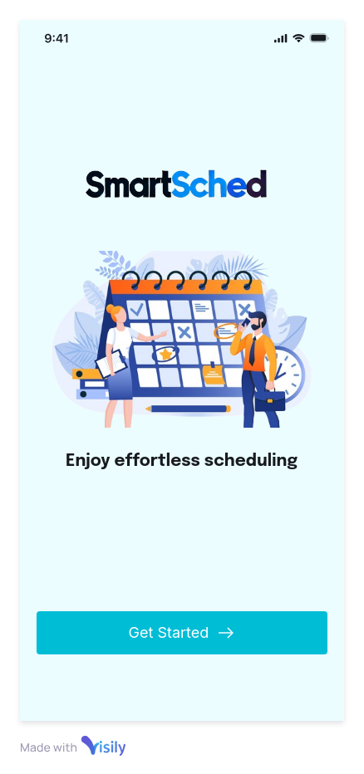
SmartSched: Smart Scheduling with Chatbot

Slide 4
Product Vision
FOR students and professionals WHO need to manage their schedules, THE SmartSched: Smart Scheduling with Chatbot is a mobile application THAT can manage entire schedules using alerts for when to go to class, attend meetings or a get together, summarize upcoming week's to-do list, keep track of everyone's busy schedules and suggest the perfect time to schedule a meeting UNLIKE other products like Calendly, Doodle and Todoist etc., that is either for enterprise level project management or at a personal level can only automate meetings, manage daily tasks and give reminders. OUR PRODUCT provides AI-assistance with chatbot for scheduling meetings and can suggest suitable meeting times by analyzing schedules of a group of people.
Notes:
https://app.visily.ai/projects/8d974fed-b938-46bf-8ef9-6c6369b96c5b/boards/1243254/presenter?play-mode=Prototype

Slide 5
Why SmartSched?
Other Apps
Task Summarization: Unlike other scheduling apps, our app provides a weekly task summary, ensuring that users stay on top of their priorities with ease.
Automated Scheduling Assistant (Schedule-Bot): Our app features a Schedule-Bot that automates the process, reducing manual scheduling efforts compared to apps like Calendly or Scheduler AI.
"Find the Slot" Feature: This unique feature intelligently finds optimal meeting slots, providing more flexibility and convenience than apps like Doodle or Reclaim.
Calendly
Doodle
Todoist
Motion
Reclaim

Slide 6
Features
Authentication
Summarization of Weekly Tasks
"Find the Slot" to Schedule Meeting
Upcoming Meetings Reminder
Schedule Meeting Manually
Schedule-Bot

Slide 7
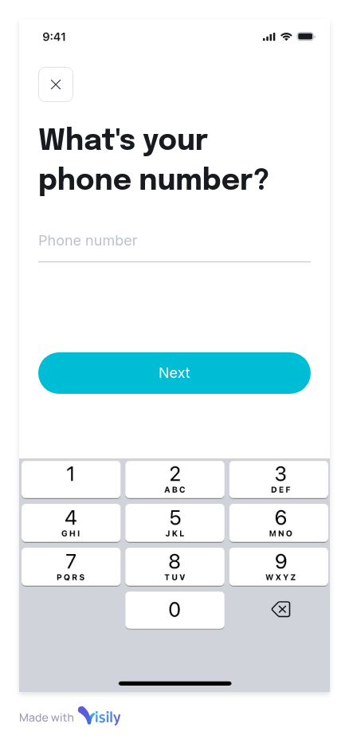
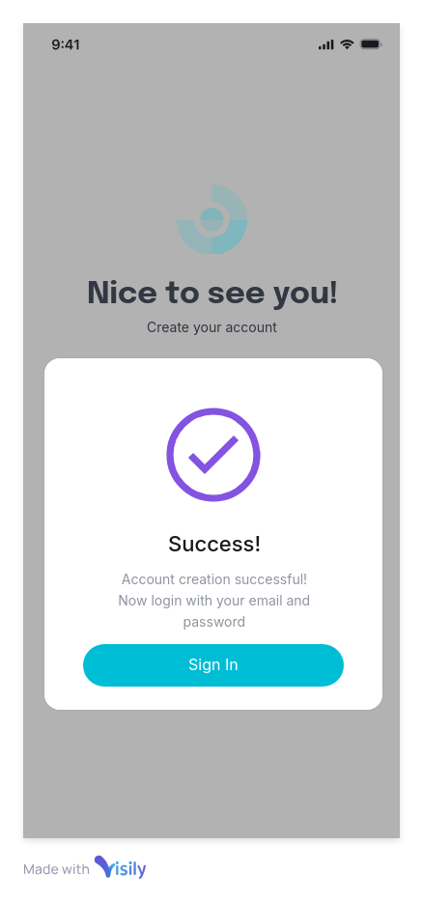
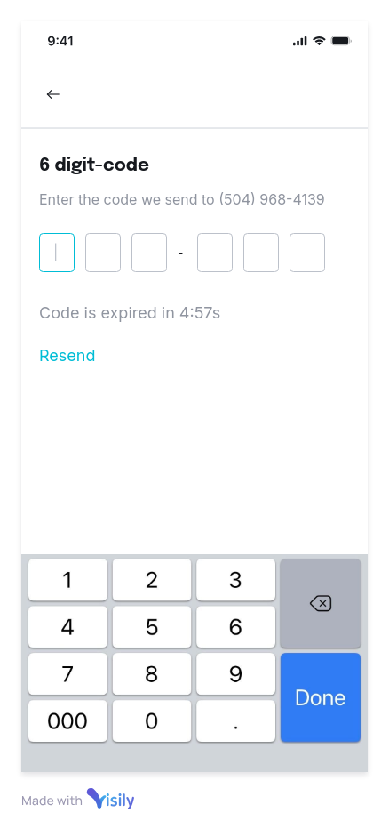
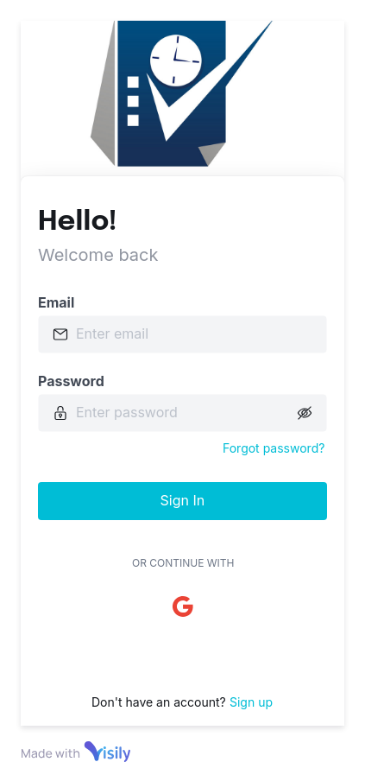
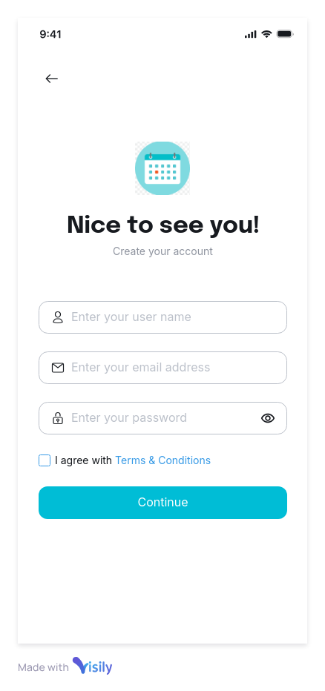
Authentication

Slide 8
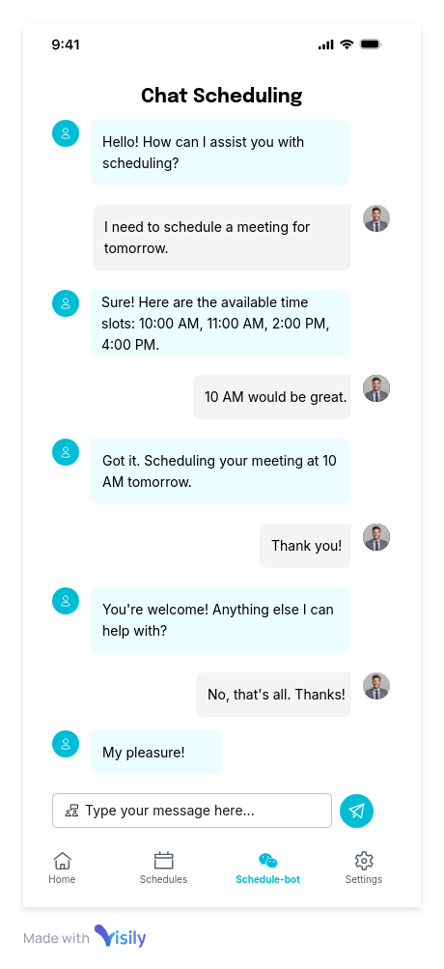
Schedule-Bot

Slide 9
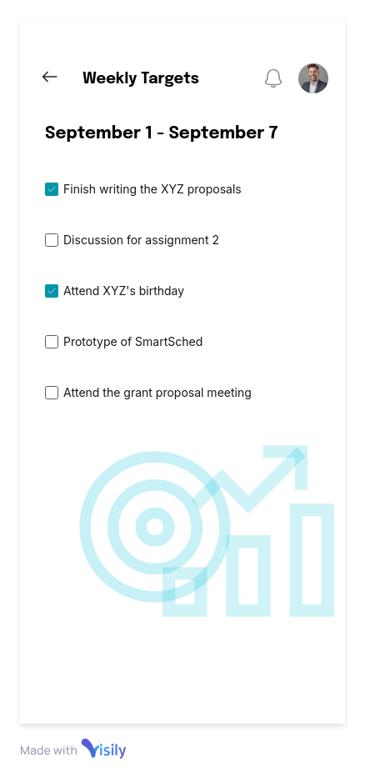
Summarization of Weekly Tasks

Slide 10
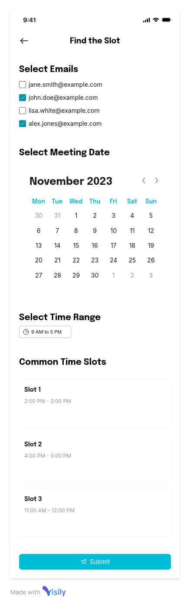
Find the Slot!

Slide 11
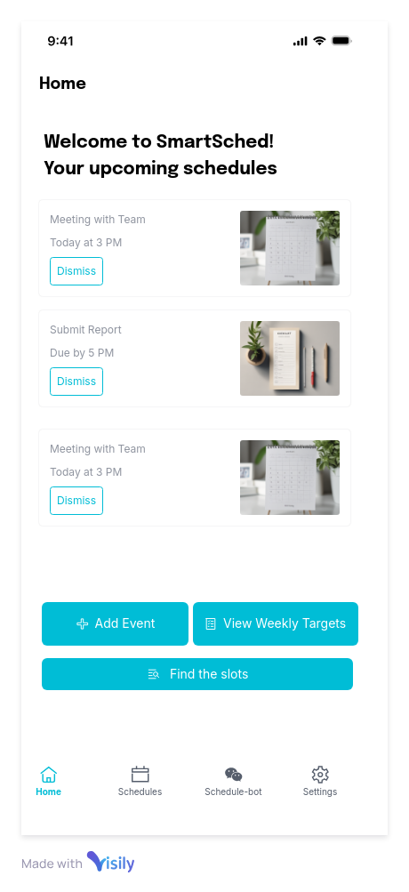
Upcoming Meetings reminder

Slide 12
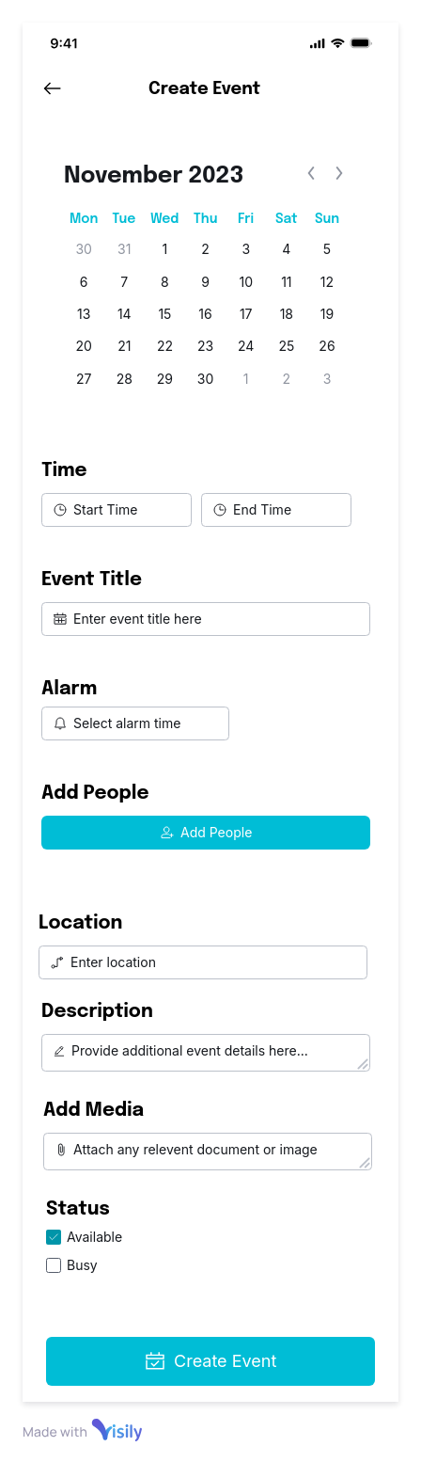
Schedule Meeting Manually

Slide 13

Prototype Details
No learning curve
Wide range of design templates
Screenshot to Design
Text to Design AI tool
Convert to Figma

Slide 14
Proposal 2 Finbot: Personal Finance Management with Chatbot

Slide 15
Product Vision
FOR people facing challenges in managing their finances WHO wants to track their personal daily transactional activities and categorize the amount they spend and get some insights on their purchases THE FinBot: AI-Driven Personal Finance Manager is a mobile application THAT tracks daily transactions, financial goals and categorizes spending based on receipt images using AI UNLIKE other apps like wallet, mint and ynab etc. which only handles daily finances in manual manner. OUR PRODUCT provides AI-assistance with which users can generate customized financial reports and get answers regarding financial history questions through a chatbot.

Slide 16
Why FinBot over other apps?
Our Uniqueness:
AI Chatbot can answer questions regarding financial history
Customized Reports
The chatbot can generate custom plots and charts based on user demands
Educational Resources
Send timely articles to improve financial
Goal Setting
Alert user based on financial goals
Notifications
Spending out of budget
Other Apps:
Mint
YouNeedABudget
Good Budget
Pocket Guard
Wally
Wallet

Slide 17
Features
Customized Reports
Personalized AI Chatbot
Goals and Notifications
Educational Resources
Daily Tracking of Transactions
Categorizing Expenses from Receipt Images

Slide 18
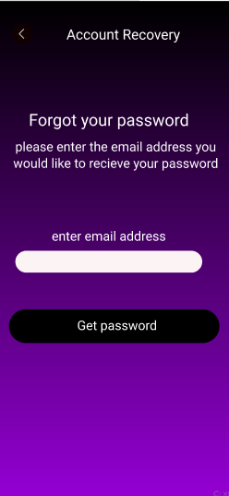
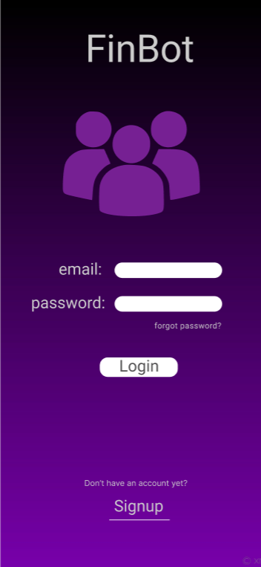
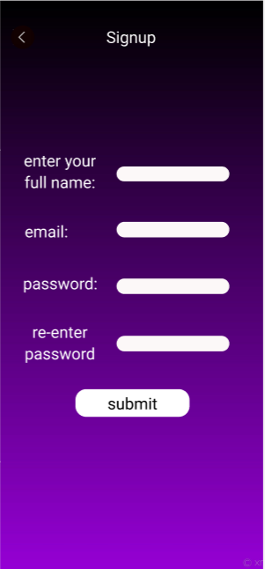

Slide 19
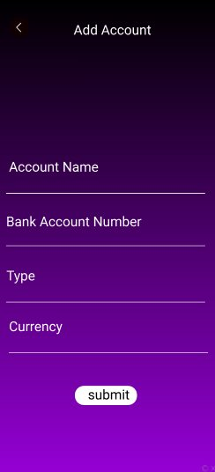
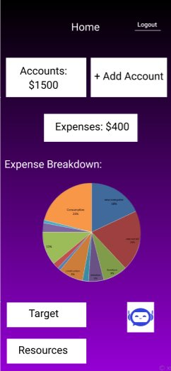
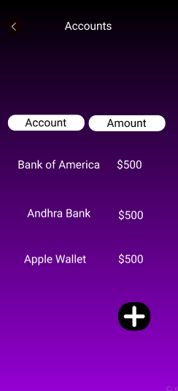

Slide 20
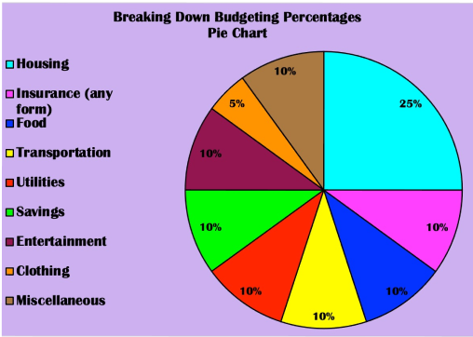
Feature #1
Customized Reports – Based off the spending, a report will be generated

Slide 21

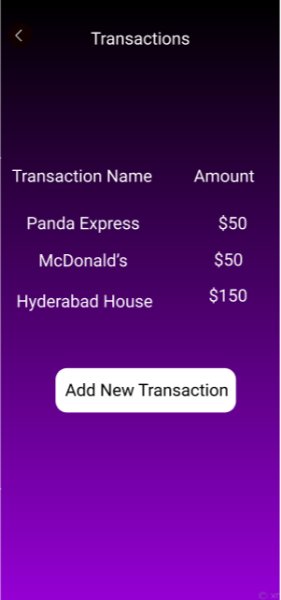
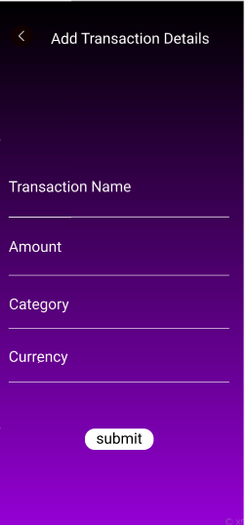
Feature #2
Transactions - Tracking daily expenses or transactions

Slide 22

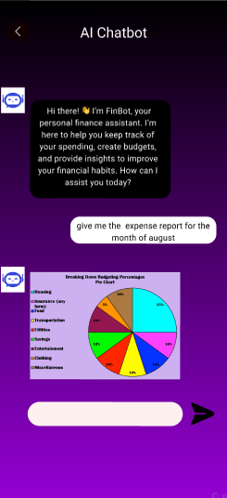
Feature #3
Personalized AI chatbot - Personal conversation with a chatbot where we can ask specific questions of our transaction summary.

Slide 23
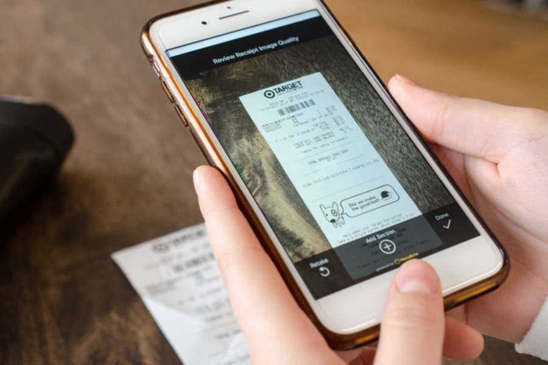
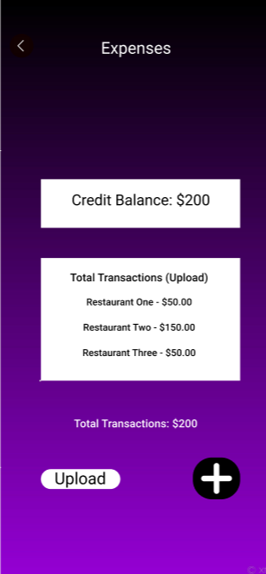
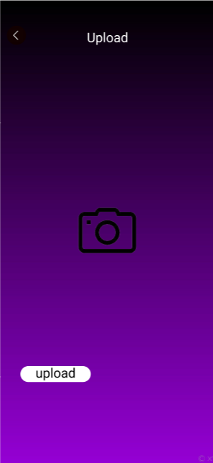
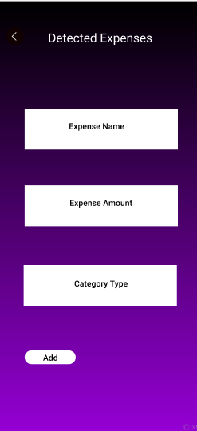
Feature #4
Categorizing spending based on receipt images – Add and categorize the receipt images in the expenses

Slide 24
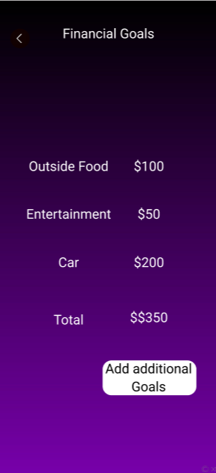
Feature #5
Goals & Notifications

Slide 25
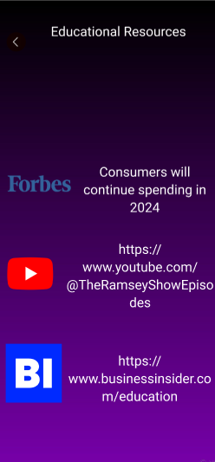
Feature #6
Educational Resources

Slide 26
Prototype Details: Figma
Navigation Tools
Real Time Collaboration
Component Design
Easy File Sharing – Offline Access

Slide 27

Implementation Details
Development Platforms: Ubuntu/Windows, Ram: 8GB, Intel Core i7 CPU, Android Studio
Frontend: Flutter
Language: Dart, Python
Database: PostgresSQL
Version Control & Issue Tracker: GitHub
Prototype tool: Figma, Visily
Deployment: CI/CD
Backend: FastAPI, ChatGPT (Summarizer, Visualization Plots)

Slide 28
Thank You

